Slide 1
Uber Eats vs DoorDash
Brand Differentiation and Sentiments

Slide 2
Problem Statement
Analyst from Uber Eats, attempting to find out if there is brand differentiation between our platform and Door Dash, and what are the general trends in vernacular that our Uber Eats community, both drivers and users, are using.
These will seek to inform our marketing team about how we can bring out brand forward, and also our platform/product management team on how we can improve our services.

Slide 3
Approach
Brand Differentiation
Multinomial NB
CVEC
TVEC
Random Forests
Random Forest
Extra Trees
Confusion matrix
Identification of mis-identified items
Platform Sentiment gathering
Top word counts
Feature weights
Notes:
Brand differentiation:
By building and optimising the model to see the difference between Uber Eats and Doordash, we will be able to find out the core differences between our drivers and users, and see what attributes are tagged to our brands respectively. I
Platform sentiment gathering:
Sentiments as in the main words tagged to our platform, which can help us find out more about the
For our platform, if a comment is negatively tagged as Door Dash is what we want to minimize, as we want to find out as much sentiments as we can about

Slide 4
Stop words used:
“english”
'dashers', 'dashing', 'dashpass', 'eats','door', 'dash', 'doordash', 'Uber', 'UberEATS', 'ubereats', 'uber’, 'dasher’
DashPass is a unique pass to the DoorDash dashers community, to pay $9.99 /month or $96 yearly to get free delivery for orders above $12

Slide 5
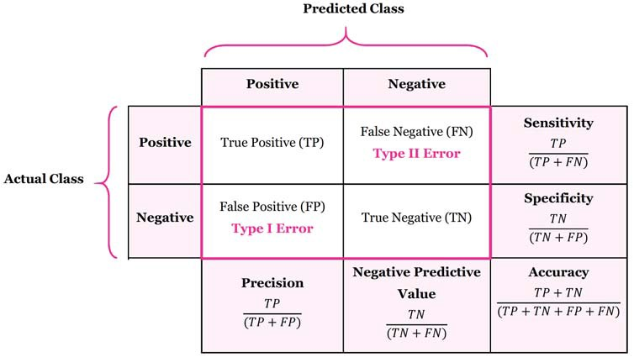
Concerned about accuracy – we want to accurately sort the reddit comments so that we can do an analysis on the words that contribute to Branding for, and between, the companies.
A high accuracy would mean that model can tell us distinguishing features in the form of words/ bigrams

Slide 6
Optimisation of the models
 |  | Best Params | Best_score | Score on Train Set | Score on Test Set
Multinomial NB | CVEC | - | 0.6502 | 0.8148 | 0.6611
Multinomial NB | CVEC | {'cvec__max_df': 0.45, 'cvec__max_features': 10000, 'cvec__min_df': 1, 'cvec__ngram_range': (1, 2)} | 0.6681 | 0.7910 | 0.6732
Multinomial NB | TVEC | {'tvec__max_df': 0.3, 'tvec__max_features': 11000, 'tvec__min_df': 3, 'tvec__ngram_range': (1, 4)} | 0.6957 | 0.8377 | 0.6873
Random Forests | CVEC | 'rf__ccp_alpha': 0, ‘ rf__max_depth': 7, 'rf__max_features': 'sqrt', 'rf__min_samples_leaf': 7, 'rf__min_samples_split': 15, 'rf__n_estimators': 200 | 0.6402 | 0.6749 | 0.6341
Extra Trees | CVEC | 'et__ccp_alpha': 0, ‘ et__max_depth': 6, 'et__max_features': 0.5, 'et__min_samples_leaf': 7, 'et__min_samples_split': 10, 'et__n_estimators': 200 | 0.6059 | 0.6121 | 0.6041

Slide 7
Optimisation of the models
 |  | Best Params | Best_score | Score on Train Set | Score on Test Set
Multinomial NB | CVEC | - | 0.6502 | 0.8148 | 0.6611
Multinomial NB | CVEC | {'cvec__max_df': 0.45, 'cvec__max_features': 10000, 'cvec__min_df': 1, 'cvec__ngram_range': (1, 2)} | 0.6681 | 0.7910 | 0.6732
Multinomial NB | TVEC | {'tvec__max_df': 0.3, 'tvec__max_features': 11000, 'tvec__min_df': 3, 'tvec__ngram_range': (1, 4)} | 0.6957 | 0.8377 | 0.6873
Random Forests | CVEC | 'rf__ccp_alpha': 0, ‘ rf__max_depth': 7, 'rf__max_features': 'sqrt', 'rf__min_samples_leaf': 7, 'rf__min_samples_split': 15, 'rf__n_estimators': 200 | 0.6402 | 0.6749 | 0.6341
Extra Trees | CVEC | 'et__ccp_alpha': 0, ‘ et__max_depth': 6, 'et__max_features': 0.5, 'et__min_samples_leaf': 7, 'et__min_samples_split': 10, 'et__n_estimators': 200 | 0.6059 | 0.6121 | 0.6041

Slide 8
Multinomial NB - TVEC

Slide 9
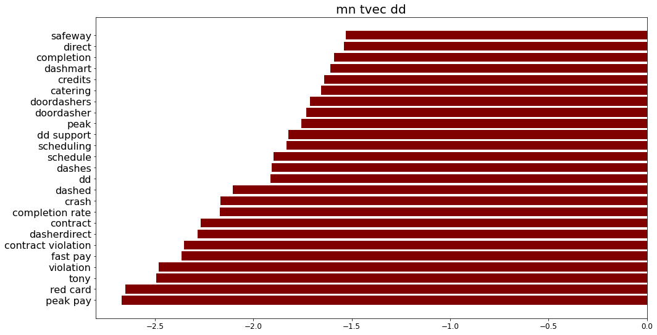
Multinomial NB - TVEC

Slide 10
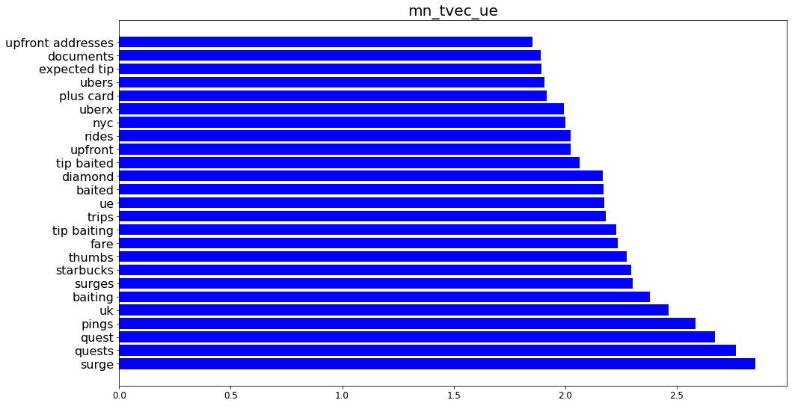
Multinomial NB - TVEC

Slide 11
Multinomial NB - TVEC
Red – Card vs Plus Card
A type of payment form where Dashers use the card to pay for the order, debited from DoorDash
There is an analogous type of payment for Uber Eats, called the Plus Card.
Using VADER, VADER (Valence Aware Dictionary and sEntiment Reasoner) the sentiments towards the cards are:
Surge
In the context of our Uber Eats platform, surge can be a good or bad phenomenon for our drivers.
VADER Compound score of 0.0720 which is quite neutral.
Message containing: | VADER Compound Score
Red Card | 0.2533
Plus Card | 0.3912

Slide 12
Multinomial NB - TVEC
Quests
“Quest promotions offer you the opportunity to earn extra money for reaching certain trip goals in a set amount of time.”
“For example: Get an extra $50 by completing 10 trips between 4am on Monday and 4am on Friday.
Quests are only mildly positive
This does not mean that quests are bad for our customers, but we can understand the circumstances which made it less pleasant.
How do I not care?I just a got another thumbs down. Second one today. \n\nThis guy changed his address, which cost me my quest because I added his order on since it was at the same apartment. He ended up at a house. I handed it off to him, with a real attitude he says “thank you” and I say real quietly, because not only am I very mad, and very tired after going since 11, “you’re welcome”. \n\nLike what the fuck was I supposed to do? Roll out the magic carpet after you cost me my last part of my quest? I’m so sick of these people. Maybe I could have been nicer or whatever, but still. Now im at 93 percent. \n\nSo how do I not care so much when it’s all I know? I care about people being happy with their service, doing a good job. It’s how I’ve always been, whether I was a janitor or a Fulfillment Team Lead. This shit is really starting to get to me. I don’t want people to see I have 7 thumbs downs and think I don’t care or I don’t deserve a tip.

Slide 13
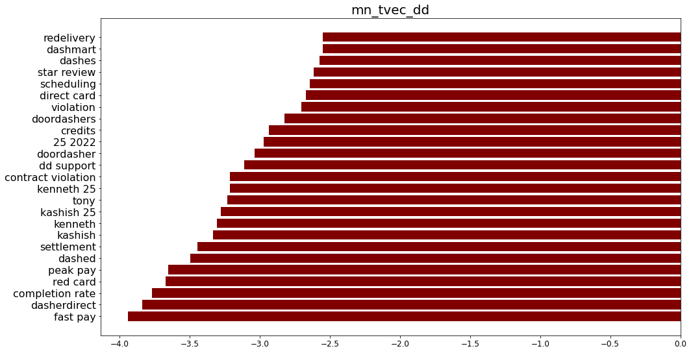
Multinomial NB - CVEC

Slide 14
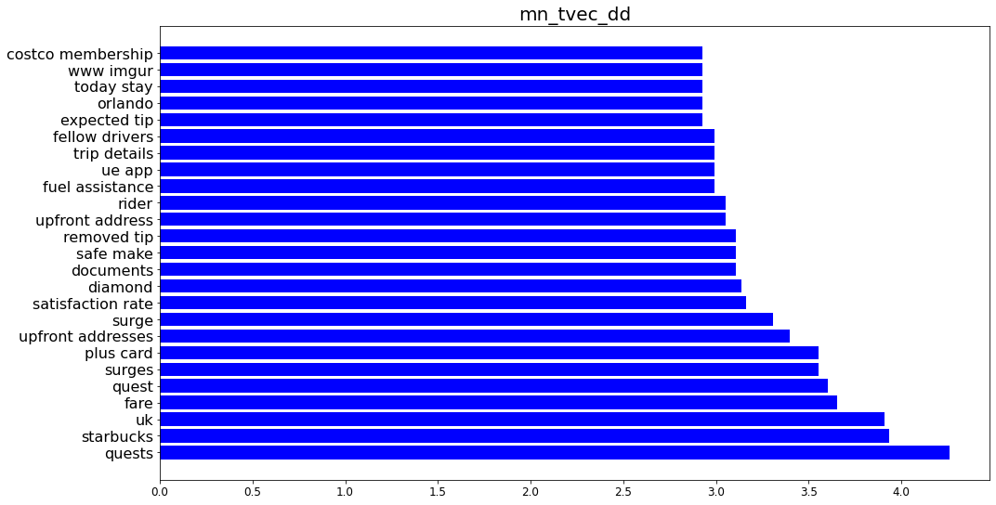
Multinomial NB - CVEC

Slide 15
Multinomial NB - CVEC
Red – Card vs Plus Card still present
Quests and surge for our company- still a distinguishing factor
Tony
CEO of DoorDash
VADER compound score of 0.5211 seems good
Further inspection, some are sarcasm.
“Saving soooo much ⛽️ Drove about 1300 miles this week for DD. Saved a whopping 1.1 cent per mile :))) Thanks tony 👎🏼”
“Thank you Tony for your beautiful $2 orders all hail tony”

Slide 16
Multinomial NB - Insights
Great insights as we are able to tell the feature weights that lean towards either company
Useful for our analysis
Brand differentiation
Sentiment gathering

Slide 17
Random Forests

Slide 18
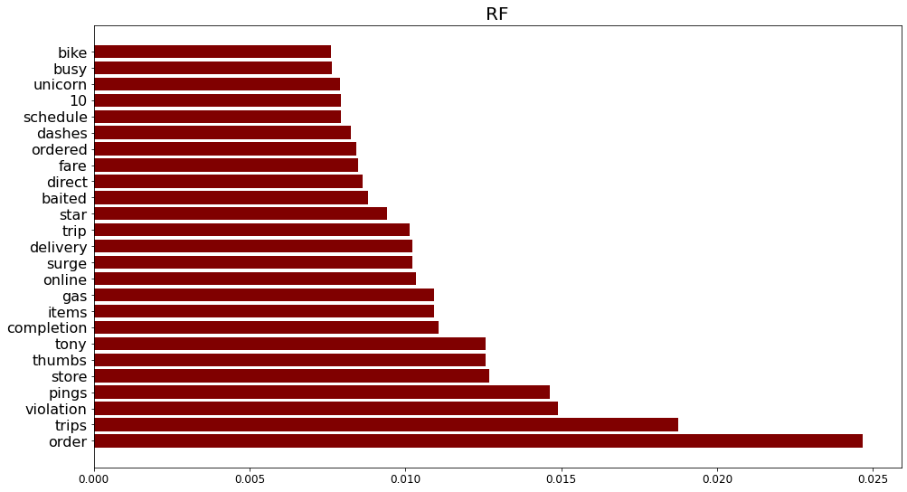
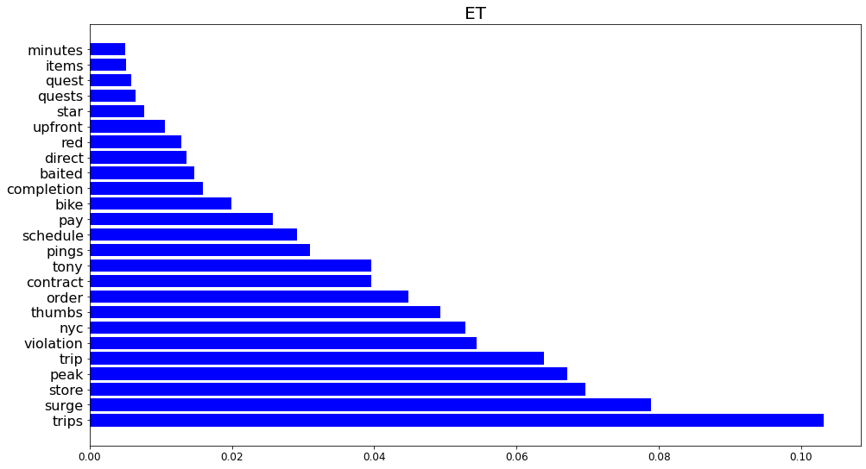
Random Forest
Surge has the highest significance, aword that has appeared with our previous counts.

Slide 19
Top Word Counts

Slide 20
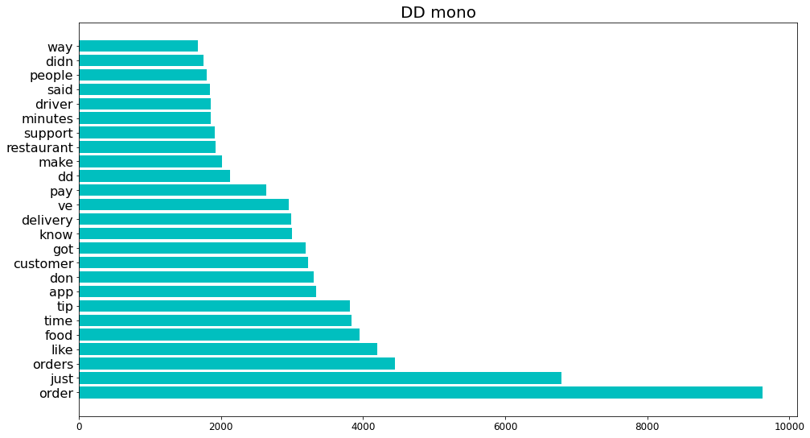
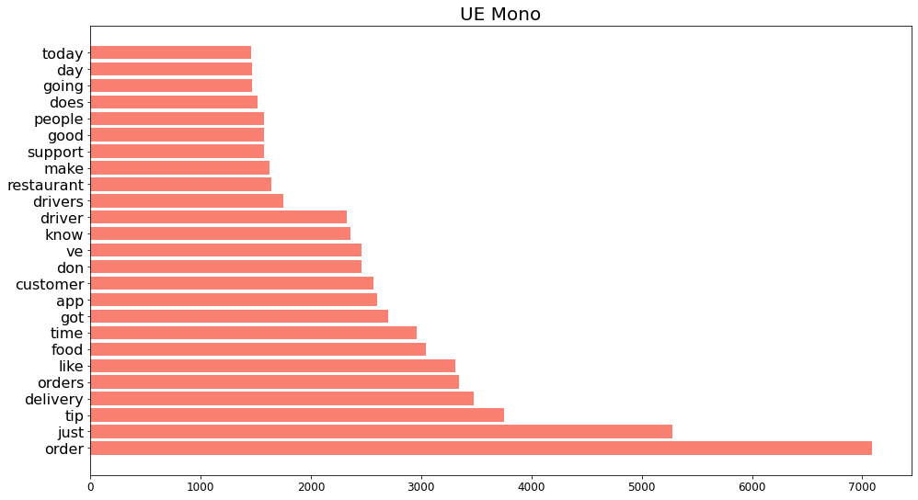
We can observe that there are quite a few similarities between the two lists of most common words.
“people”, “restaurant”, “got”, “support”, “time”, “customer”, “food”, “like”, “orders”, “just”
We see that there are quite a few counts of “good” in our UE set
Not present in DD set.

Slide 21
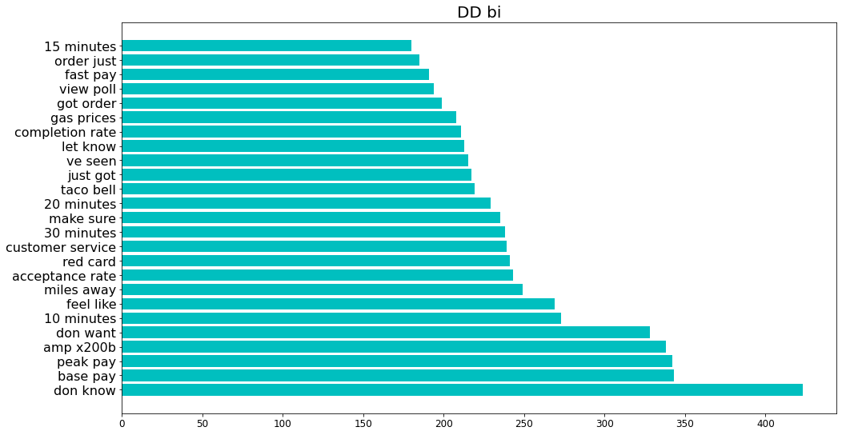
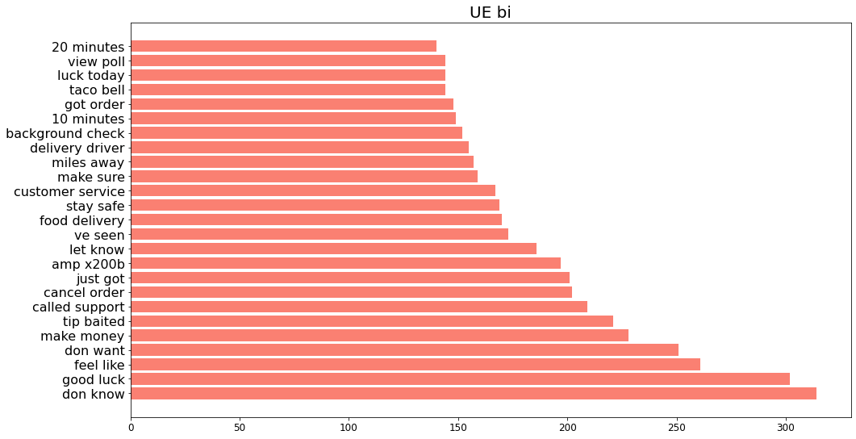
Top words seem to be about timing
“10 minutes”
“30 minutes”

Slide 22
Top words seem to be about timing
We applied VADER to data containing “minutes”
10 minutes and 20 minutes for both companies, and 30 minutes for DoorDash
See if sentiments are similar or different regarding time-related words
The score is mildly negative, but not as much as DoorDash's. Could be similar that people generally would not like to wait for so long for picking up orders or receiving orders.
Company | VADER Compound Score
DoorDash | -0.0427
Uber Eats | -0.0017

Slide 23
Exploring positive sentiments in our dataset
“Good” seems to be the flavour of the time period for our company.
Has a VADER compound score of 0.4092.
Might allude to this period being a good time for our drivers and users, and can be a form of sentiment gathering
Whether it appears in a certain time period
Whether it appears in the other company’s dataset

Slide 24
Challenges met by the team
Stop words being found at various points of modelling- have to re-run whole model
Modelling takes a long time, have to be especially clear which models and which parameter you are changing
Multiple GridSearch functions
Improvements:
Would have just tried to find out the maximal model as soon as possible
Understand that each project is unique, and to define own problem statement early – model accuracy is not the only portion that is important.
Would have explored TVEC for all of them as it seemed to be a better fit on hindsight.

Slide 25
Words associated with our brands
DoorDash | Uber Eats
Red Card | Plus Card
Tony | Surge
 | Quests
 | “good”
Common words: Minutes

Slide 26
Conclusions
Words that might be associated with our brands
“Plus Card”, “Quest”
These seem to show a mild to intermediate positive trend
Our branding have at least one tangible anchor: Quests
“Surge”
We would have to take note of the surges, which is particular only to our company, to ensure that it is positive for the drivers.
Possibly temporal
Trend in vernacular towards our brand
“Good”
We seem to be enjoying a positive trend in this time period
Trend in vernacular towards food delivery
“Minutes”
Seems to have mild negative scores for now
Have to note and possibly find out reasons

Slide 27
Recommendations
Words that are of importance in this time frame of 03 Oct 2021 to 26 March 2022:
We will have to continuously measure these data to update our knowledge of our drivers and users, and our branding
We can do more textual analysis into “good” messages to find out more about the trend and what caused our community to feel positive, as well as messages with “minutes” to find the root cause of the issue if any.

Slide 28
Thank you

